Slide 1
Inheritance and Polymorphism in PHP (OOP)

Slide 2
Learning Objectives
1. By the end of this lesson, you should be able to:
2. Understand the concept and purpose of inheritance in OOP.
3. Understand the relationship between base and derived classes.
4. Demonstrate method overriding to customize inherited behavior.
5. Use the parent:: keyword to enhance inherited methods in derived classes.
6. Explain and implement polymorphism using a common base class.

Slide 3
What is Inheritance?
Inheritance allows a class to reuse the properties and methods of another class.
The base class is also called the parent class.
The derived class is also called the child class.
Promotes code reuse and modularity.

Slide 4
Roles of Base and Derived Classes
Role | Description
Base Class | The general class (e.g., Person)
Derived Class | The specialized class (e.g., Student)

Slide 5
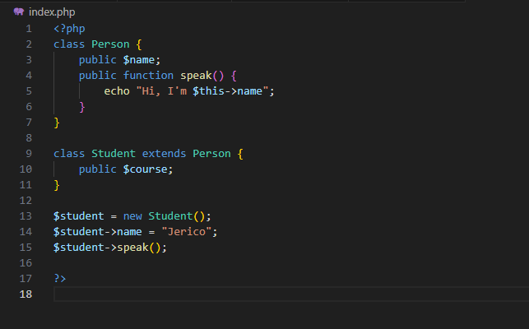
SYNTAX EXAMPLE

Slide 6
What is Method Overriding?
Method overriding allows a child class to redefine a method from the parent class.
Used to customize or change inherited behavior.

Slide 7
SYNTAX EXAMPLE

Slide 8
Effective delivery techniques
This is a powerful tool in public speaking. It involves varying pitch, tone, and volume to convey emotion, emphasize points, and maintain interest:
Pitch variation
Tone inflection
Volume control
Effective body language enhances your message, making it more impactful and memorable:
Meaningful eye contact
Purposeful gestures
Maintain good posture
Control your expressions

Slide 9
Navigating Q&A sessions
Know your material in advance
Anticipate common questions
Rehearse your responses
Maintaining composure during the Q&A session is essential for projecting confidence and authority. Consider the following tips for staying composed:
Stay calm
Actively listen
Pause and reflect
Maintain eye contact

Slide 10

Speaking impact
Your ability to communicate effectively will leave a lasting impact on your audience
Effectively communicating involves not only delivering a message but also resonating with the experiences, values, and emotions of those listening

Slide 11
Dynamic delivery
Learn to infuse energy into your delivery to leave a lasting impression.
One of the goals of effective communication is to motivate your audience.
Metric | Measurement | Target | Actual
Audience attendance | # of attendees | 150 | 120
Engagement duration | Minutes | 60 | 75
Q&A interaction | # of questions | 10 | 15
Positive feedback | Percentage (%) | 90 | 95
Rate of information retention | Percentage (%) | 80 | 85

Slide 12
Final tips & takeaways
Consistent rehearsal
Strengthen your familiarity
Refine delivery style
Pacing, tone, and emphasis
Timing and transitions
Aim for seamless, professional delivery
Practice audience
Enlist colleagues to listen & provide feedback
Seek feedback
Reflect on performance
Explore new techniques
Set personal goals
Iterate and adapt

Slide 13
Speaking engagement metrics
Impact factor | Measurement | Target | Achieved
Audience interaction | Percentage (%) | 85 | 88
Knowledge retention | Percentage (%) | 75 | 80
Post-presentation surveys | Average rating | 4.2 | 4.5
Referral rate | Percentage (%) | 10 | 12
Collaboration opportunities | # of opportunities | 8 | 10

Slide 14
Thank you
Brita Tamm
502-555-0152
brita@firstupconsultants.com
www.firstupconsultants.com

